Slide 1
“Multi-Label Image Classification on the COCO Dataset”
Semester project presentation
Lecture „Neural Networks and Memristive Hardware Accelerators”
Group: W Students: Felipe Zuleta – Mariana Muñoz – Karen Vargas – Rehan Karthik Day of presentation: 4th February 2025

Slide 2
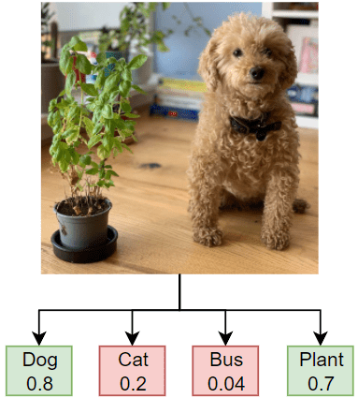
Introduction
Tasks 1. Dataset Exploration
2. Data Processing $ Augmentation
3. Building a Basic Neural Network
4. Creating a Simple CNN
5. Model Evaluation & Metrics
6. Transfer Learning with pretrained Models
7. Understanding Parameters & FLOPs

Slide 3
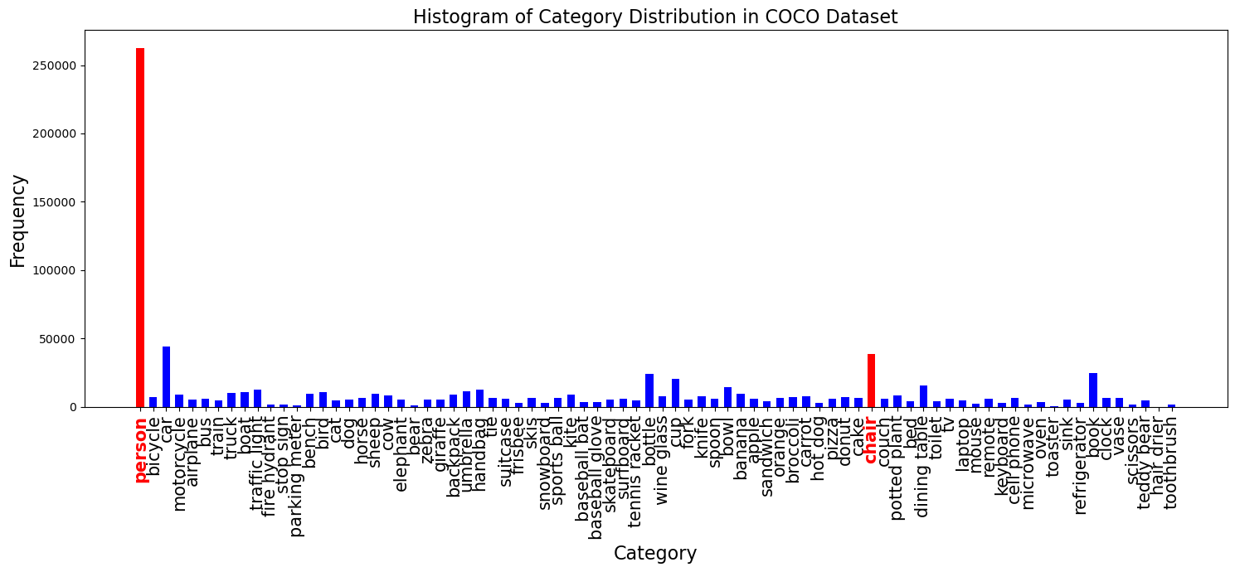
Dataset Exploration and Understanding (Task 1) COCO-Train-2017 dataset
COCO Dataset structure
118287 images
Annotations JSON:
- info
- licenses
- images
- file_name
- id
- annotations
- segmentation
- image_id
- bbox
- category_id
- id
- categories
Labels 80

Slide 4
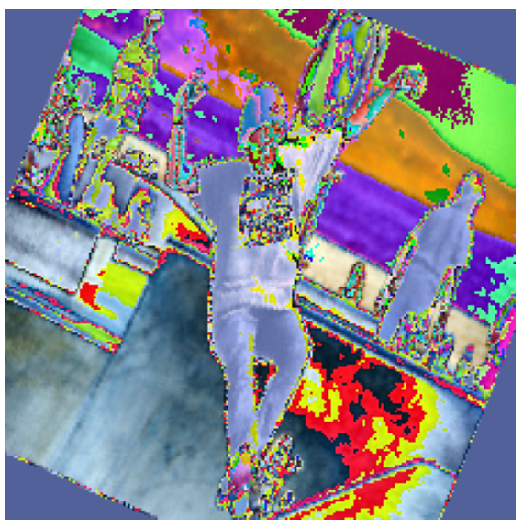
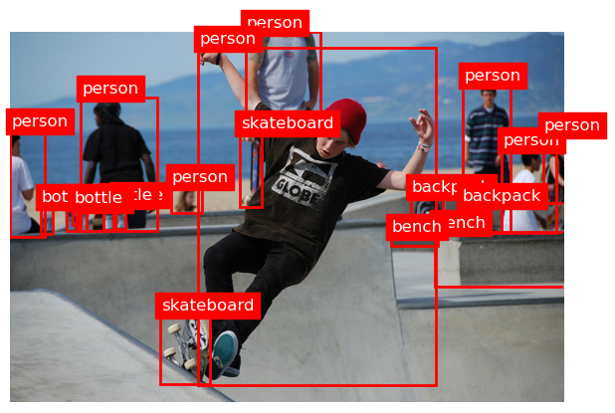
Data Preprocessing and Augmentation (Task 2)
Preprocessing steps:
Resizing (224x224)
Normalizing: mean[0.485, 0.456, 0.406]
std [0.229, 0.224, 0.225]
Augmentation techniques (flipping and cropping)
Dataset Split
Training: 80%
Validation: 10%
Test: 10%

Slide 5
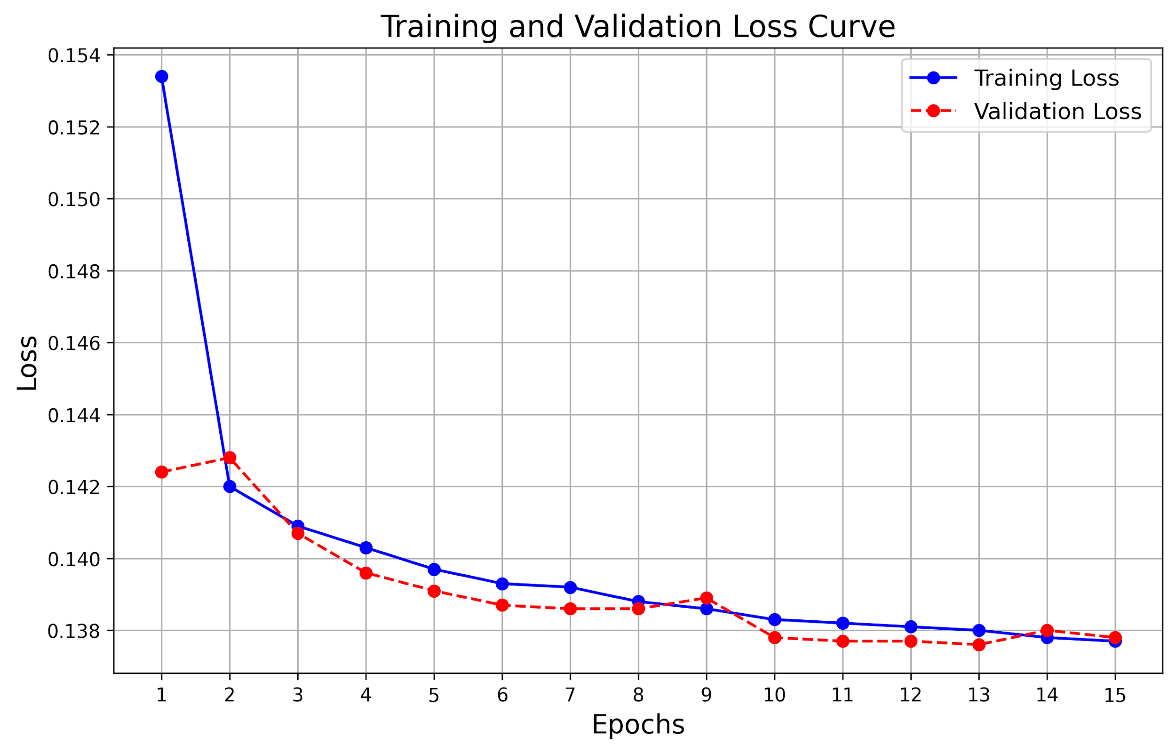
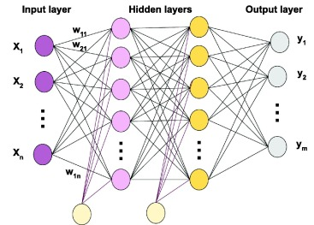
Build a basic Neural Network (Task 3)
MLP (Multi-Layer Perceptron model)
Architecture details
Input size (224x224x3)
Hidden layers (512) with ReLu Activation
Output layer (80) with Sigmoid Activation
Training process overview
Epochs (15)
Batch size (16)
Loss function (BCE)
Learning rate (0.01)

Slide 6
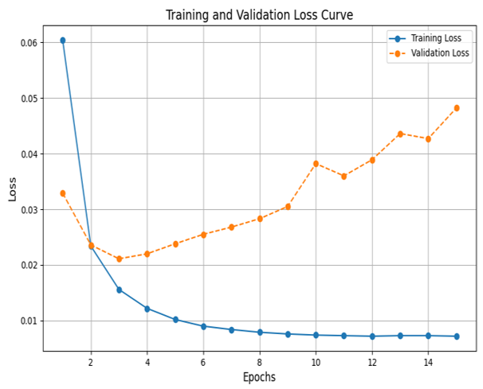
Build a simple CNN (Task 4) Convolutional Neural Network
Architecture details
Input size (224x224x3)
3 convolutional layers
(16, 32, 64 filters) with ReLu Activation
2x2 Max pooling after each convolutional layer
Output layers (80) with Sigmoid Activation
Training process overview
Epochs (15)
Batch size (16)
Loss function (BCE)
Learning rate (0.01)

Slide 7
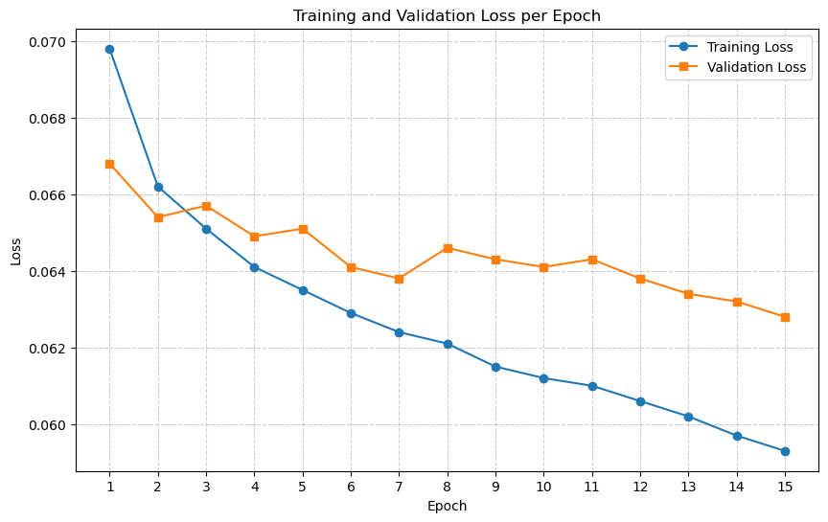
Transfer Learning with Pretrained Models
(Task 6)
ResNet50 model (Pretrained)
Weights: IMAGENET_V1
Normalizing: mean[0.485, 0.456, 0.406]
std [0.229, 0.224, 0.225]
Modified Fully Connected (FC) Layer
Activations (Sigmoid)
Output layer (80)
ResNet50 model (not Pretrained)
Weights: NONE

Slide 8
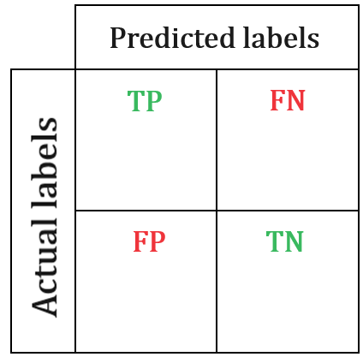
Confusion Matrix
MLP
CNN
1.0
0.0
0.0
1.0
0.89
0.11
0.0
1.0
1.0
0.0
0.0
1.0
0.18
0.82
0.0
1.0
Person
Chair
Person
Chair
Pretrained ResNet 50
0.87
0.13
0.38
0.62
0.06
0.94
0.02
0.98
Person
Chair

Slide 9
Model Evaluation and Metrics (Task 5) Comparative performance for all three models
Model | Label | Accuracy | Precision | Recall | F1 Score
CNN | Person | 0.8612 | 0.8594 | 0.8930 | 0.8759
 | Chair | 0.9849 | 0.9594 | 0.9616 | 0.9605
MLP | Person | 0.5485 | 0.5485 | 1.0000 | 0.7084
 | Chair | 0.8921 | 0.0000 | 0.0000 | 0.0000
ResNet50 | Person | 0.9017 | 0.9472 | 0.8675 | 0.9056
 | Chair | 0.9277 | 0.7220 | 0.3800 | 0.4979

Slide 10
Parameters and FLOPs (Task 7)
 | MLP | CNN | ResNet50
Params | 77.38M | 4.54M | 23.77M
fwd MACs | 1.24G | 2.27G | 65.4G
fwd FLOPs | 2.48G | 4.6G | 131.32G

Slide 11
Summary
The class imbalance causes the MLP to detect a person in any input image, but the CNN and ResNet50 models solve that issue.
The ResNet50 model performs better on average represented classes.
Despite the MLP having the most parameters of all three models, it performed the worst.

Slide 12
Appendix

Slide 13
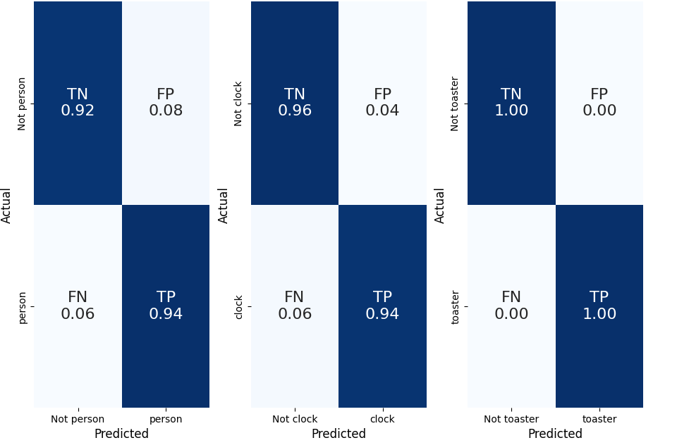
Effect of Data Imbalance on Label Classification
Category | Occurrences | Accuracy | Precision | Recall | F1 Score
Person | 262,465 | 0.93 | 0.97 | 0.94 | 0.95
Clock | 6,334 | 0.96 | 0.00 | 1.00 | 0.00
Strong Detection for "Person" label due to large number of occurrences
Precision Collapse for “Clock” reveals severe false positives

Slide 14
 | MLP | CNN | ResNet50
Params | 77.38M | 4.54M | 23.77M
fwd MACs | 1.24G | 2.27G | 65.4G
fwd FLOPs | 2.48G | 4.6G | 131.32G
fwd + bwd MACs | 3.71G | 6.81G | 196.19G
fwd + bwd FLOPs | 7.43G | 13.81G | 393.95G

